Slide 1

Psi4 1.1: Open-Source Quantum Chemistry
C. David Sherrill
School of Chemistry and Biochemistry
School of Computational Science and Engineering
Georgia Institute of Technology

Slide 2
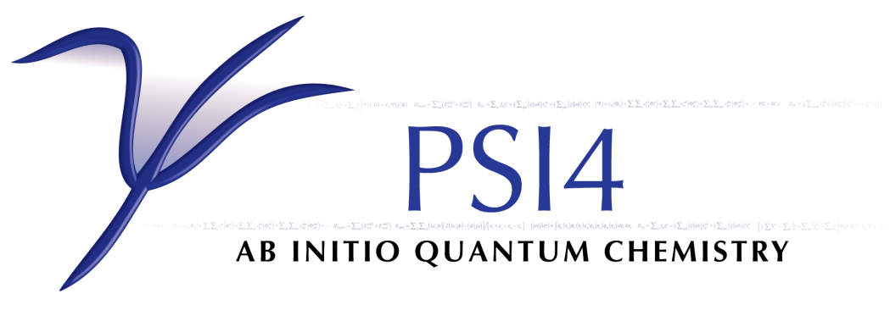
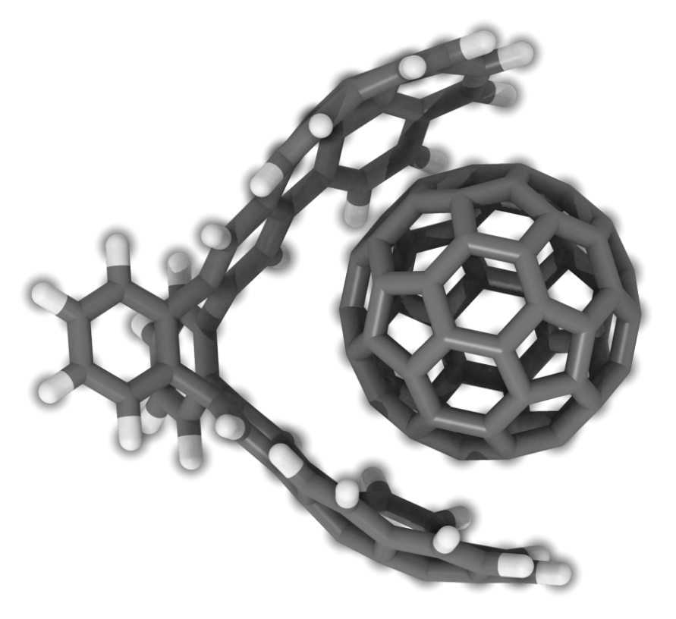
Download at
http://www.psicode.org
Freely-available, open-source
Object-oriented C++ with powerful scriptable Python user interface
New Features:
DF-DFT
DF-HF
DF-MP2, DF-CCSD(T)
DF-CCSD gradients
DCFT
DF-SAPT
DF-MCSCF
Optimized-orbital MP2, MP3
PCM
X2C scalar relativistic corrections
Built-in database features
Very user-friendly input
J. M. Turney , A. C. Simmonett, R. M. Parrish, E. G. Hohenstein, et al., WIREs: Comput. Mol. Sci., 2, 556-565 (2012)

Slide 3
PSI4: Core Team
Research Groups:
David Sherrill (Georgia Tech)
Daniel Crawford (Virginia Tech)
Fritz Schaefer (University of Georgia)
Francesco Evangelista (Emory University)
Rollin King (Bethel University)
Eugene DePrince (Florida State University)
Edward Hohenstein (City College of New York)
Ugur Bozkaya (Ataturk University, Turkey)
Edward Valeev (Virginia Tech)
Main Infrastructure Programmers:
Lori Burns (Georgia Tech)
Daniel Smith (Georgia Tech)
Andy Simmonett (NIH)
Justin “Jet” Turney (U Georgia)
Rob Parrish (Georgia Tech)
Ryan Richard (Georgia Tech)

Slide 4
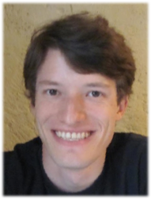
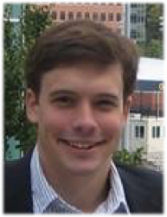
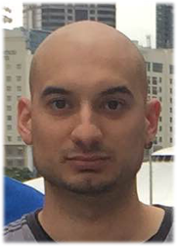
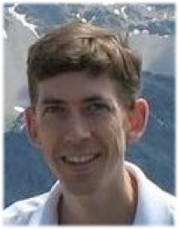
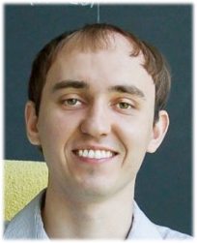
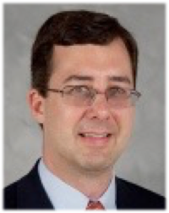
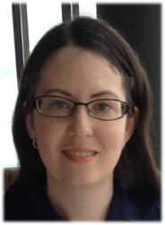
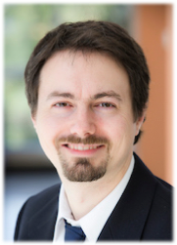
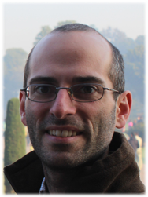
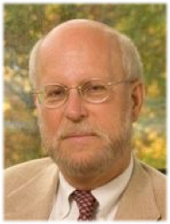
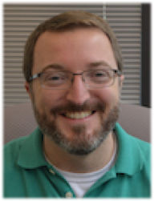
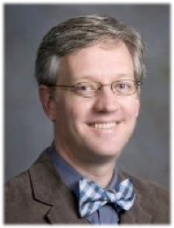
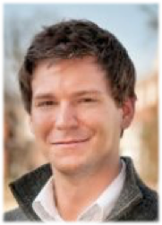
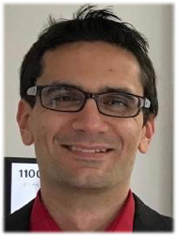
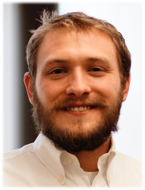
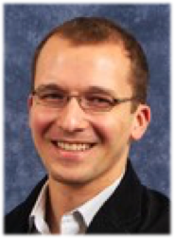
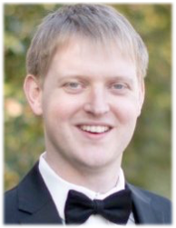
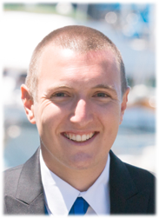
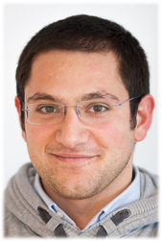
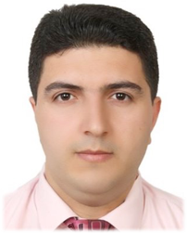
Core Psi4 Contributors
Jerome Gonthier
Berkeley
Rob Parrish
Stanford
Ryan Richard
Iowa State
Rollin King
Bethel
Alexander Sokolov
Ohio State
David Sherrill
GaTech
Lori Burns
GaTech
Francesco Evangelista
Emory
Eugene DePrince
FSU
Fritz Schaefer
UGA
Justin Turney
UGA
Daniel Crawford
VaTech
Daniel Smith
MolSSI
Ben Pritchard
MolSSI
Andrew James
VaTech
Ed Valeev
VaTech
Andy Simmonett
NIH
Ed Hohenstein
CCNY
Roberto Di Remigio
Tromso
Ugur Bozkaya
Hacettepe

Slide 5
Goals of the Psi4 Project
Provide free, open-source software for quantum chemistry
Make the code fast
Make the code easy to use
Provide good documentation for users
Provide a robust infrastructure for rapid development of new theoretical methods
Make the code friendly to reusable libraries, add-ons, plugins, etc. Promote development of reusable software components

Slide 6
Psi4: The Paper
J. M. Turney et al., WIREs: Comput. Mol. Sci. 2, 556 (2012)
Published July/August 2012
ISI “Highly Cited Paper”: In the top 1% of the field of Chemistry based on a highly cited threshold for the field and publication year
254 citations as of April 2017
2nd paper under review in J. Chem. Theory Comput.

Slide 7
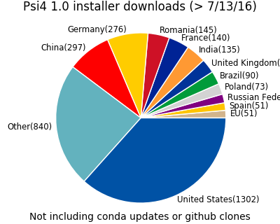
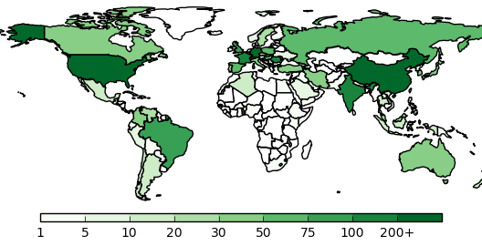
Psi4 Downloads
7

Slide 8
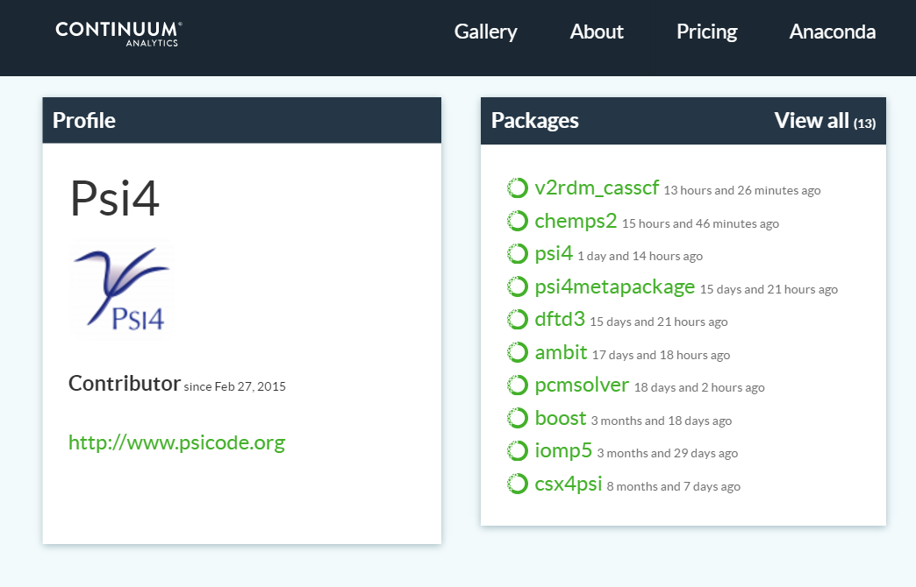
Psi4 Binaries and Interfaced Packages Available via Anaconda

Slide 9
PSI4 Code Overview
C++ with a Python driver
User input specified in quantum-chemistry-specific directives plus (optionally) any valid Python code (we call it “Psithon”); the quantum chemistry directives are translated into valid Python and then the input is executed as Python
ca. 1 million lines of code
Basic libraries (e.g., to generate electron repulsion integrals, figure out orbital ordering, etc., in src/lib) are called by “modules” which implement particular quantum methods (DFT, Hartree—Fock, MP2, etc., in src/bin)
We have moved to a single-executable model
Most heavily used and/or newer parts of the code are threaded, usually with OpenMP

Slide 10
Example Psi4 Input: Avoiding Tedious Molecule Specification
set basis = aug-cc-pVDZ
molecule { pubchem:benzene
}
optimize(‘mp2’)
This performs an MP2 optimization on benzene. No Z-matrix,
no Cartesian coordinates!

Slide 11
New: Composite Methods Made Incredibly Easy
molecule mol {
H
F 1 1.0
}
energy('B3LYP/cc-pVDZ')
energy('SCF/cc-pV[DTQ]Z')
energy('MP2/aug-cc-pV[DT]Z')
energy('MP2/aug-cc-pV[TQ]Z + D:CCSD(T)/cc-pV[DT]Z')
optimize('MP2/aug-cc-pV[DT]Z')

Slide 12
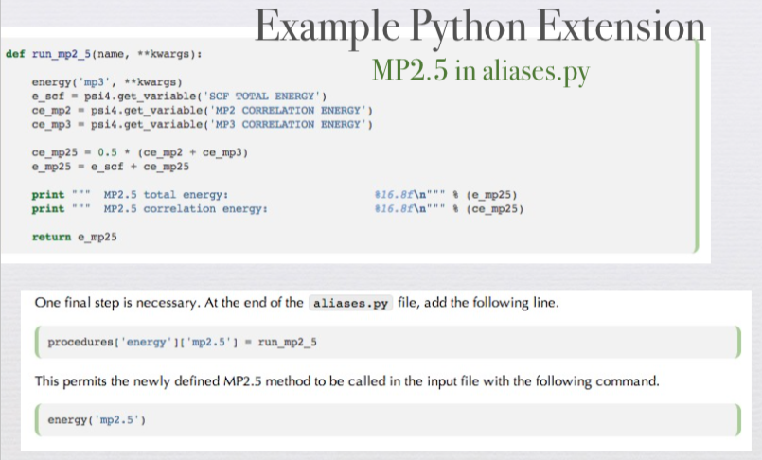
Convenience of Python to “Power Users”

Slide 13
Exporting Data with Pandas
import numpy as np
import pandas as pd
molecule mol { He -- He 1 dist dist = 2.0 } distances = np.linspace(2, 10, 10) data = pd.DataFrame(index=distances)

Slide 14
Exporting Data with Pandas
for dist in distances: print('Now computing distance %3.2f' % dist) # Set new mol distnace and print energy mol.dist = dist val = energy('MP2/aug-cc-pV[DT]Z', bsse_type=['cp', 'nocp']) # Iterate over the current variable list and write to pandas for k, v, in get_variables().iteritems(): data.ix[dist, k] = v # Writes out every Psi4 variable in various formats data.to_csv('He_dimer_energy_curve.csv') data.to_json('He_dimer_energy_curve.json') data.to_excel('He_dimer_energy_curve.excel')

Slide 15
Automation of Many-Body Expansion of Clusters
energy('MP2/aug-cc-pV[DT]Z', bsse_type=['vmfc', 'nocp', 'cp'], max_nbody=3) # ==> N-Body: Counterpoise Corrected (CP) energies <== # # n-Body Total Energy [Eh] I.E. [kcal/mol] Delta [kcal/mol] # 1 -381.860713854543 0.000000000000 0.000000000000 # 2 -381.898482184307 -23.699985725859 -23.699985725859 # 3 -381.905552493580 -28.136671962670 -4.436686236811 # # # ==> N-Body: Non-Counterpoise Corrected (NoCP) energies <== # # n-Body Total Energy [Eh] I.E. [kcal/mol] Delta [kcal/mol] # 1 -381.850262217227 0.000000000000 0.000000000000 # 2 -381.899140199358 -30.671398128525 -30.671398128525 # 3 -381.905511520180 -34.669462471261 -3.998064342736 # # # ==> N-Body: Valiron-Mayer Function Couterpoise (VMFC) energies <== # # n-Body Total Energy [Eh] I.E. [kcal/mol] Delta [kcal/mol] # 1 -381.850262217227 0.000000000000 0.000000000000 # 2 -381.887928813543 -23.636147021277 -23.636147021277 # 3 -381.894997100868 -28.071564466201 -4.435417444925

Slide 16
New: Manipulating Psi4 Wavefunctions
molecule mol { H H 1 1.0 symmetry c1 } set basis cc-pVDZ set active [2] set num_roots 3 # Takes the reference SCF wavefunction and optimizes MP2 orbs omp2_e, omp2_wfn = energy('OMP2', return_wfn=True)

Slide 17
New: Manipulating Psi4 Wavefunctions
# Computes MCSCF energy with OMP2 starting orbitals mcscf_e, mcscf_wfn = energy('CASSCF', ref_wfn=omp2_wfn, return_wfn=True) # Write out MCSCF orbitals to disk molden(mcscf_wfn, ‘mcscf_orbitals.molden') # Compute some one-electron properties
oeprop(mcscf_wfn, 'QUADRUPOLE', 'ESP_AT_NUCLEI')

Slide 18
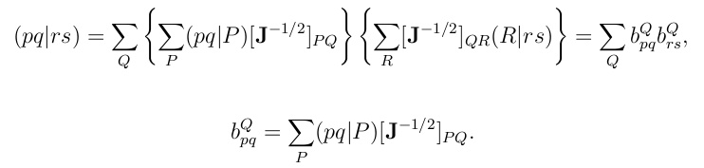
Advantages of Density-Fitting
Express four-index electron repulsion integrals (pq|rs) in terms of a smaller set of three-index integrals (pq|P)
Easier to compute, read, write, store smaller set (pq|P)
If only a limited set of MO integrals are needed, it can be much more efficient to do the AO to MO transformation using the DF integrals
J. L. Whitten, J. Chem. Phys. 58, 4496 (1973) B. I. Dunlap, J. W. D. Connolly, and J. R. Sabin, Int. J. Quantum Chem., Symp. 11, 81 (1977)
M. Feyereisen, G. Fitzgerald, and A. Kormornicki, Chem. Phys. Lett. 208, 359 (1993)
D. E. Bernholdt and R. J. Harrison, Chem. Phys. Lett. 250, 477 (1996)

Slide 19
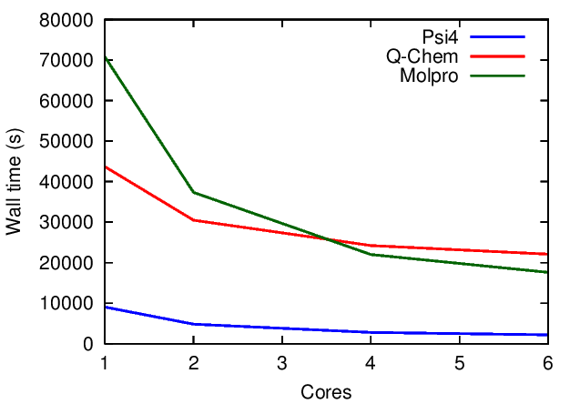
Performance
For many types of computations, we are competitive with or better than commercial codes
Benzene dimer, DF-FNO-CCSD(T)/aug-cc-pVDZ with 99.5% occupancy (conventional for Molpro)

Slide 20
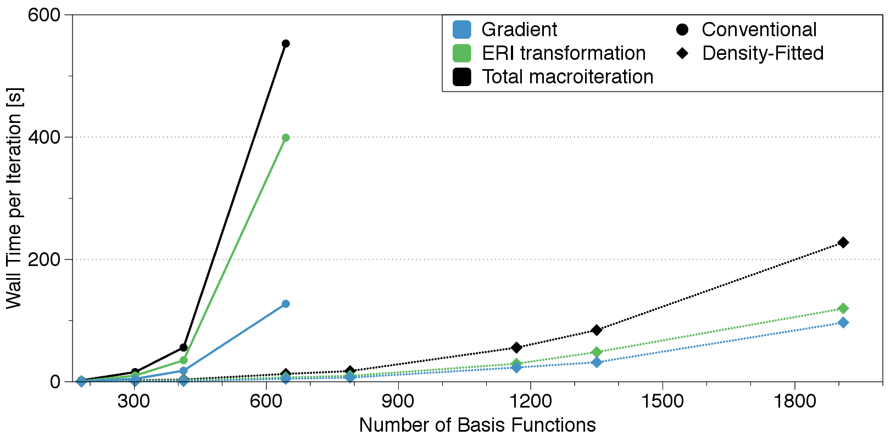
Density-Fitted RASSCF and CASSCF
(10,10) CASSCF for Naphthalene (C_{2v} symmetry) for (aug)-cc-pVXZ basis sets (timings on 6 cores)
Contribution by Daniel Smith

Slide 21
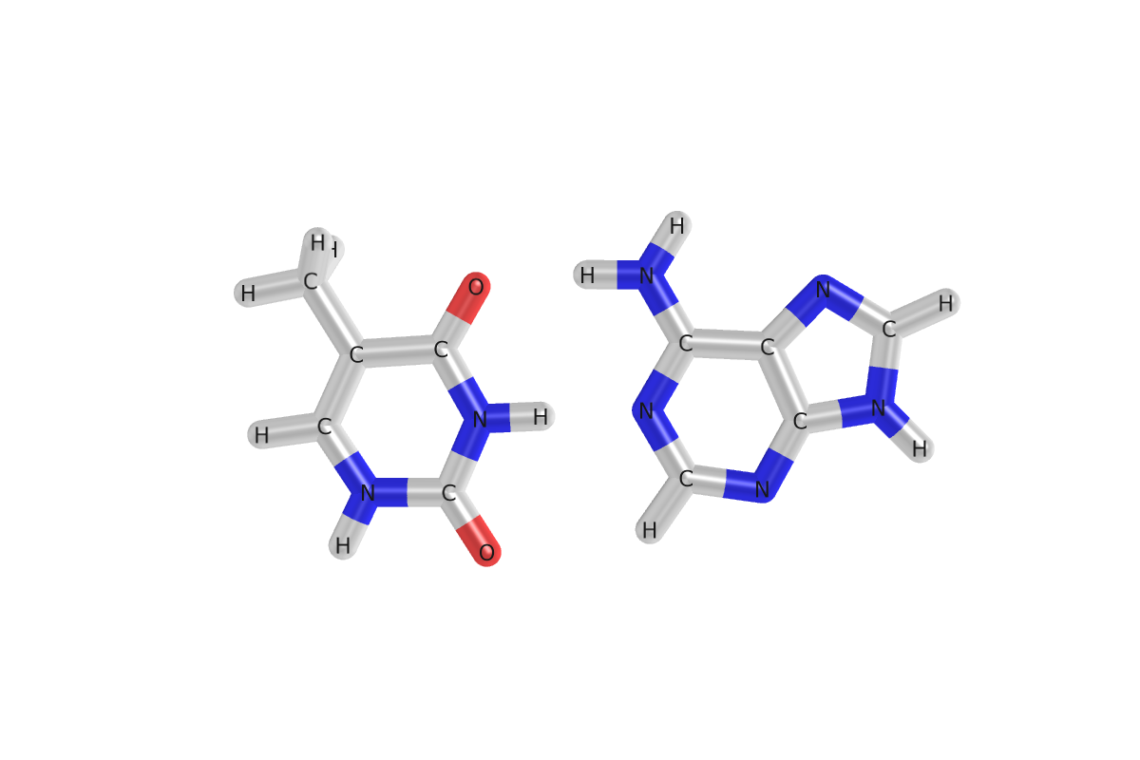
Signature Feature: Very Fast Symmetry-Adapted Perturbation Theory (SAPT) Code
In each RSPT order, adapt the dimer wavefunction to be antisymmetric!
B. Jeziorski, R. Moszynski, and K. Szalewicz, Chem. Rev. 94 1887 (1994)

Slide 22
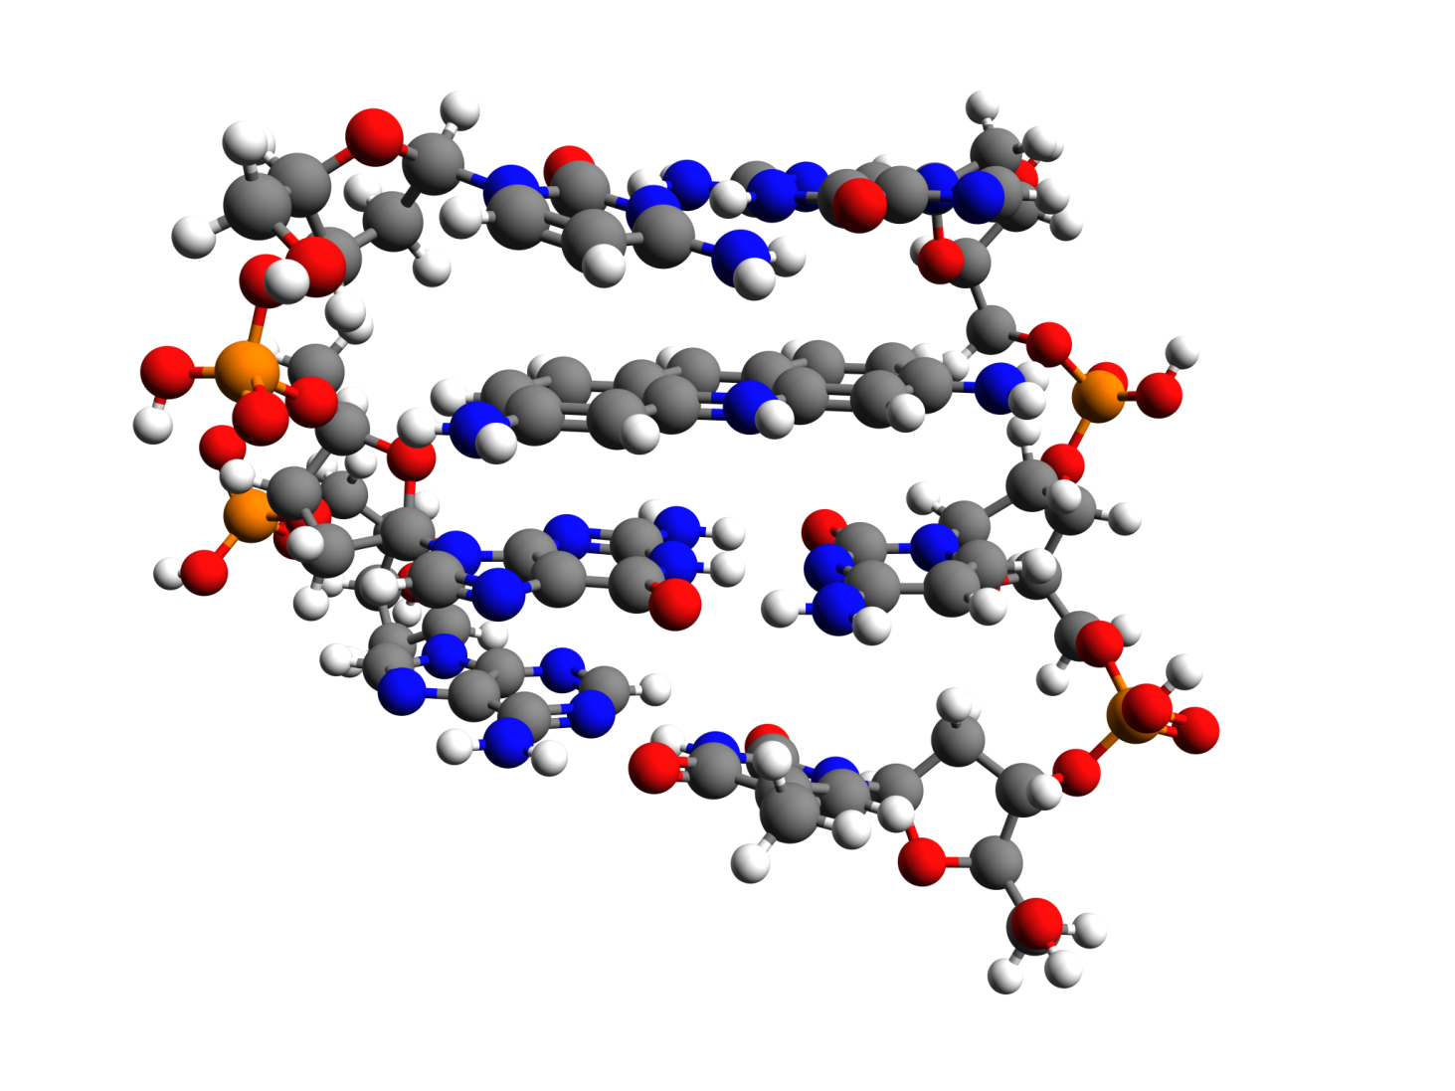
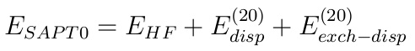
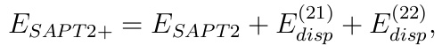
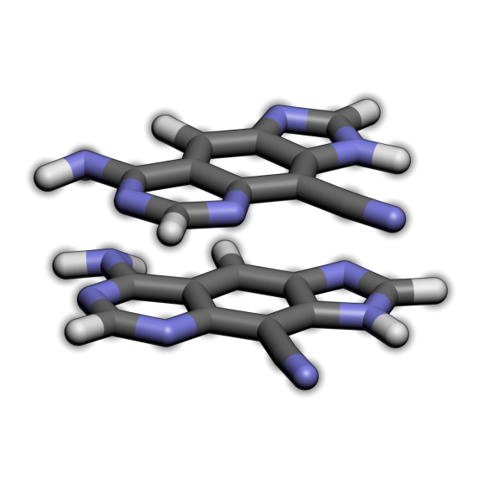
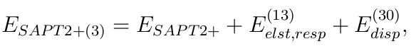
Orders of DF/CD-SAPT Implemented in PSI4
B. Jeziorski, R. Moszynski, and K. Szalewicz, Chem. Rev. 94, 1887 (1994)
E. G. Hohenstein and C. D. Sherrill, WIREs:Comput. Mol. Sci. 2, 304 (2012)
Notes:
SAPT0 scales o^2v^2Nri (construction of (ia|jb) from DF ints)
SAPT2 scales as o^2v^4 energy, v^4Nri int construction
SAPT2+ scales as o^3v^4 (triples part of Disp^(22))
SAPT2+(3) adds another o^2v^4 term (not rate-determining cf to (T) term)
Exch^1(2) = E_{exch}^(11) + E_{exch}^(12)
Ind^(30) and Exch-Ind^(30) are captured by HF and included in delta HF

Slide 23
First Generation DF-SAPT0 Code
E. G. Hohenstein and C. D. Sherrill, J. Chem. Phys. 132, 184111 (2010)

Slide 24
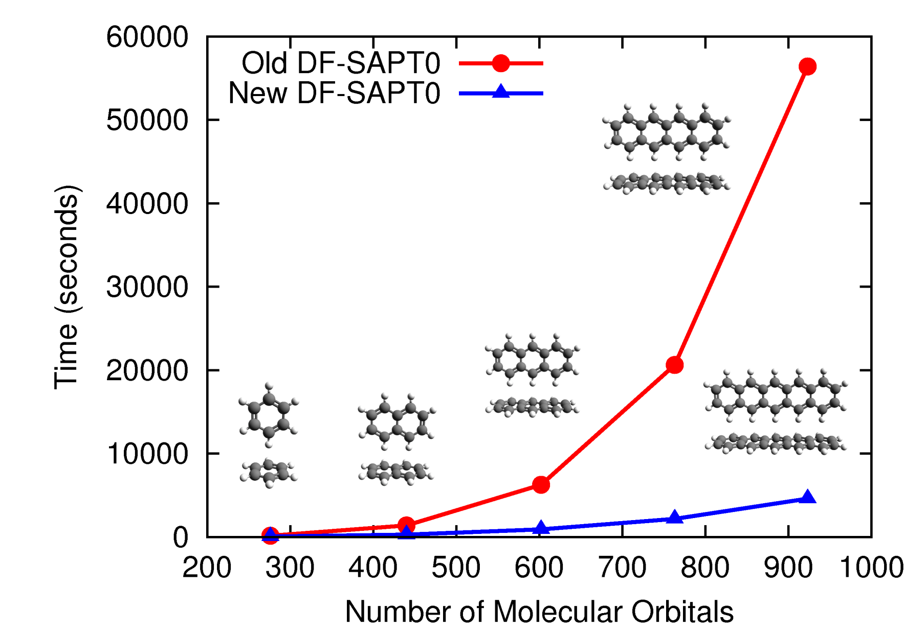
Second Generation DF-SAPT0 Code
E. G. Hohenstein, R. M. Parrish, C. D. Sherrill, J. M. Turney, and H. F. Schaefer, J. Chem. Phys. 135, 174107 (2011)

Slide 25
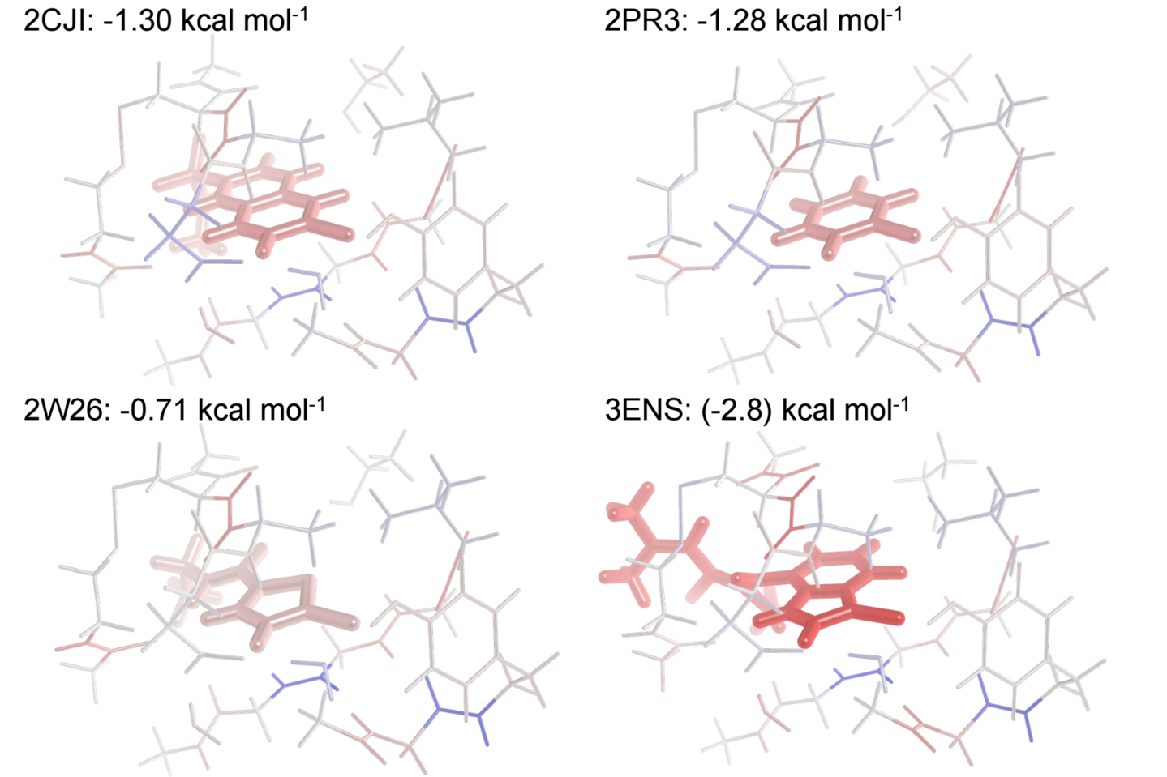
Fragment-Based SAPT (F-SAPT)
(-1.72)
(-1.41)
(expt)
(-1.06)
(-2.31)

Slide 26
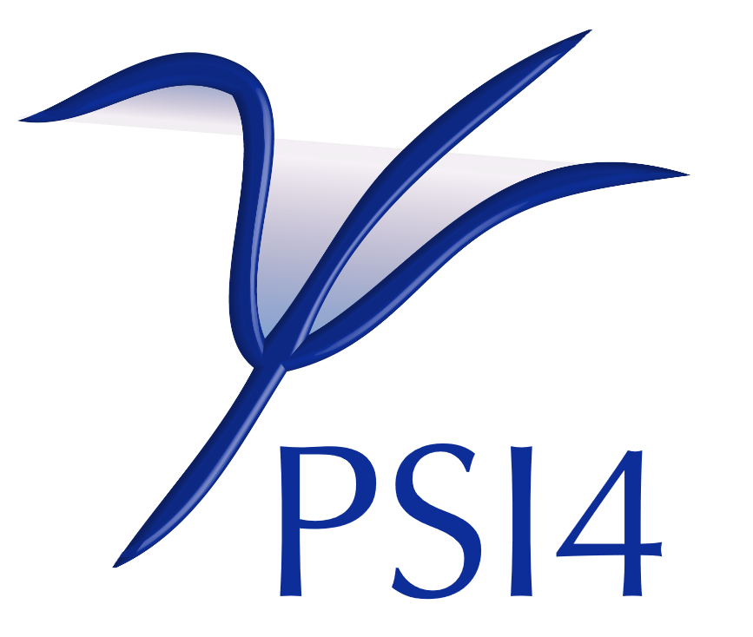
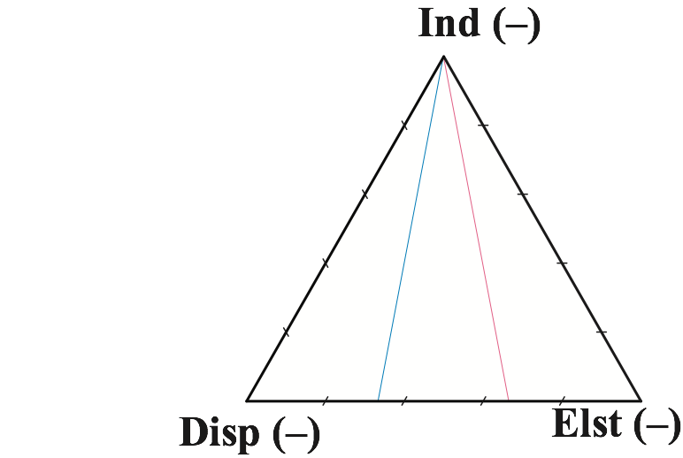
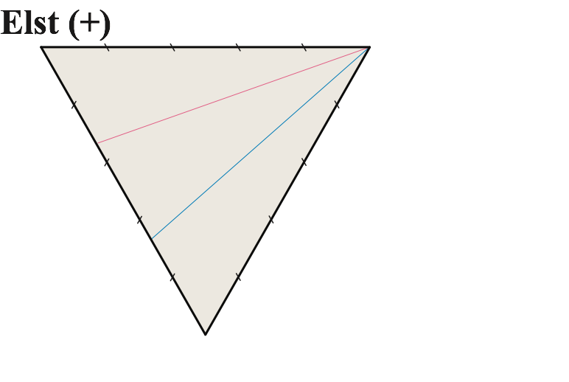
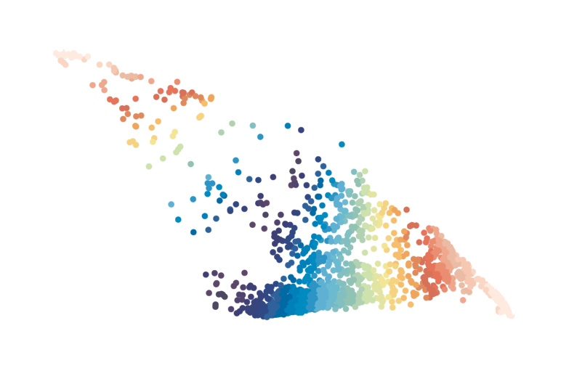

Database Tools
+
memory 2.5 gb
set basis jun-cc-pvdz
database('sapt0', 'ssi')
=
Databases built into Psi4 simplify job execution and result collection
Each colored dot characterizes a noncovalent interaction in the database SSI, as computed by the method SAPT0
Database is simple python (text) file
Build by script from xyz files
Restartable, parallel
Tabulate QC values
Access any model chemistry
Couple with other wrappers (e.g., basis extrapolation, geometry opt.)
Faver, Burns, Marshall, Zheng, Sherrill, & Merz, in preparation
26

Slide 27

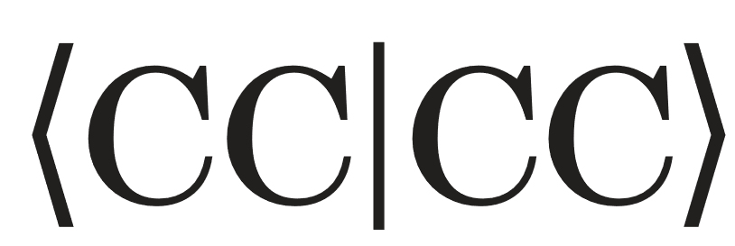

Current (Unsustainable) State of Affairs
Integrals
HF
-
MP2
CC Hessian
Integrals
HF
DFT
MP2
EFP
Integrals
HF
DFT
MP2
SAPT
Substantial duplication of effort
Delays making new methods available to users

Slide 28
Sustainability Strategy #1: “Mix & Match”
Integrals
HF
-
MP2
CC Hessian
Integrals
HF
DFT
MP2
EFP
Integrals
HF
DFT
MP2
SAPT
Not too daunting is we start by passing only basic info: geometries, basis sets, energies, gradients Hessians
But we don‘t want to write O(n²) interfaces!

Slide 29

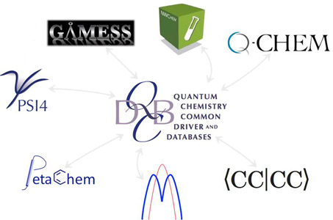
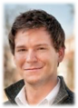
Common Driver for Quantum Chemistry
Lori Burns (Ga Tech)
Daniel Smith (Ga Tech)

Slide 30
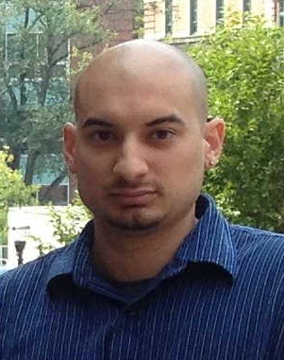
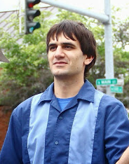
Pulsar
Provides for data exchange mechanisms for the Common Driver, and a framework for runtime addition/selection of modules
Also allows more fine-grained interoperability (e.g., switch out different integrals libraries transparently)
Harnesses coarse-grained parallelism for finite difference, BSSE, fragment-based methods, etc.
Functions mirrored in C++ and Python
Ryan Richard (Ga Tech)
Ben Pritchard (Ga Tech)

Slide 31
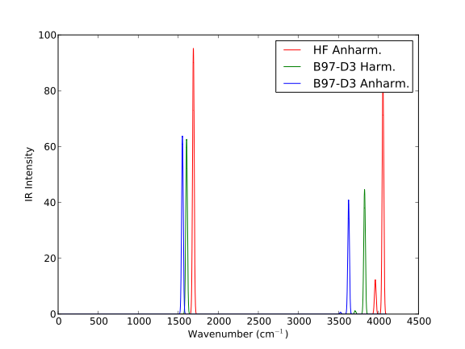

Interoperability: Best of Two Codes
 | Psi4 | CFOUR | Psi4 + CFOUR
DFT Grad. | Yes | No | Yes
Anharm. Freq. | No | Yes | Yes
DFT Anharm. Freq. | No | No | Yes
Restartable, parallel
Any gradient method from either package
Options/basis from either package
memory 4 gb
molecule h2o { O -1.51 -0.13 0.00
H -1.95 0.73 0.00
H -0.56 0.09 0.00
units angstrom
}
set basis aug-cc-pvdz
vpt2('b97-d3')
+
=
Best SCF-level vibrational spectrum from Psi4, from CFOUR, and together
Thanks to Prof. John Stanton, Devin Matthews

Slide 32
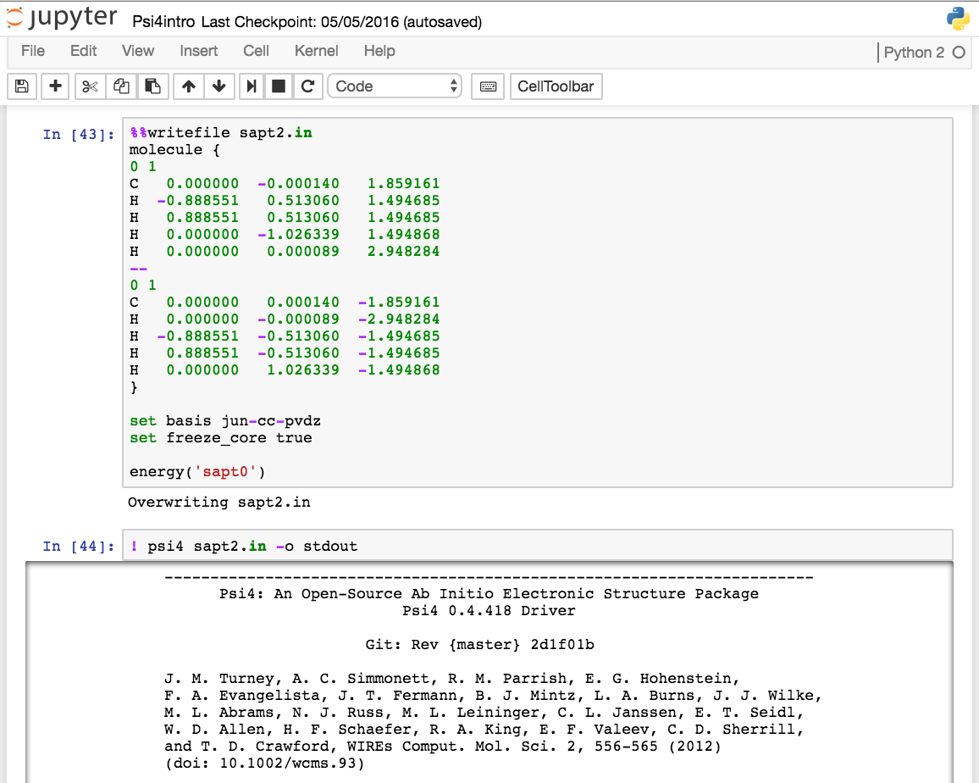
Psi4 in Jupyter Notebooks
Thanks to Prof. John Stanton, Devin Matthews

Slide 33
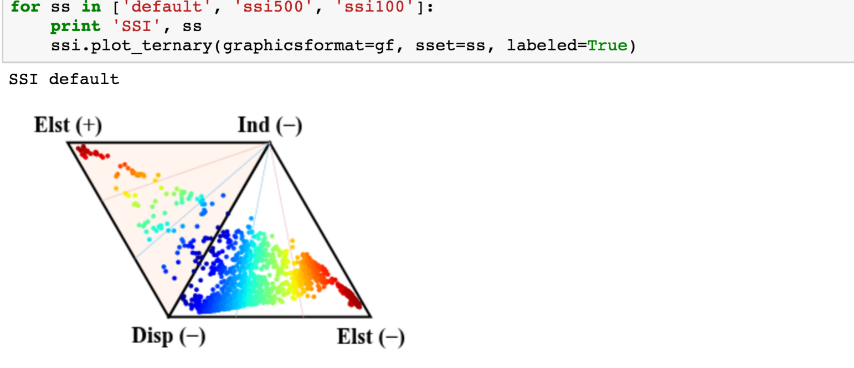
Psi4 in Jupyter Notebooks
Thanks to Prof. John Stanton, Devin Matthews

Slide 34
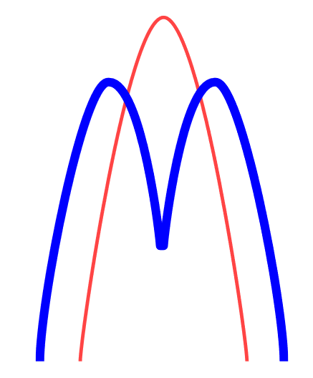




Interoperability: Pooling Capabilities
MP2
Interaction E.
–
SAPT0
Dispersion E.
+
TDDFT
Dispersion E.
=
MP2C
Interaction E.
≈
time
+
+
=
34

Slide 35


Low Barriers to QC Coding and Method Prototyping
import time
import numpy as np
from scipy import linalg as SLA
np.set_printoptions(precision=5, linewidth=200, suppress=True)
# Memory for Psi4 & numpy in GB
memory 2 GB
numpy_memory = 2
molecule mol {
O
H 1 1.1
H 1 1.1 2 104
symmetry c1
}
set {
basis cc-pVDZ
scf_type pk
guess core
mp2_type conv
e_convergence 1e-8
}
# Set defaults
maxiter = 40
E_conv = 1.0E-8
D_conv = 1.0E-5
Page 1
# A simple Psi4 input script to compute RHF reference
# Requirements scipy 0.13.0+ and numpy 1.7.2+
#
# Algorithms were taken directly from Daniel Crawford's programming website:
# http://sirius.chem.vt.edu/wiki/doku.php?id=crawdad:programming
# Special thanks to Rob Parrish for initial assistance with libmints
#
# Created by: Daniel G. A. Smith
# Date: 7/29/14
# License: GPL v3.0
https://github.com/dgasmith/psi4numpy
thanks to Daniel Smith, Patkowski Group
35

Slide 36


# Integral generation from Psi4's MintsHelper
t = time.time()
mints = MintsHelper()
S = mints.ao_overlap()
# Run a quick check to make sure everything will fit into memory
I_Size = (np.array(S).shape[0] ** 4) * 8 / 1.0E9
print "\nSize of the ERI tensor will be %4.2f GB." % I_Size
memory_footprint = I_Size * 1.5
if I_Size > numpy_memory:
clean()
raise Exception("Estimated memory utilization (%4.2f GB) exceeds numpy_memory limit of %4.2f GB." % \
(memory_footprint, numpy_memory))
T = mints.ao_potential()
V = mints.ao_kinetic()
I = mints.ao_eri()
print '\nTotal time taken for integrals: %.3f seconds.' % (time.time()-t)
# Get nbf and ndocc for closed shell molecules
t = time.time()
Z = 0
for A in range(mol.natom()):
Z += mol.Z(A)
ndocc = int(Z / 2)
nbf = S.rows(0)
print '\nNumber of occupied orbitals: %d' % ndocc
print 'Number of basis functions: %d' % nbf
# Build H_core
H = np.matrix(T) + np.matrix(V)
# Build I and reshape to rank 4 tensor
I = np.array(I).reshape(nbf, nbf, nbf, nbf)
# Orthogonalizer A = S ^ (-1/2)
A = np.matrix(SLA.sqrtm(S)).I.real
Page 2
# Calculate initial core guess
Hp = A * H * A
e, C2 = SLA.eigh(Hp)
C = A * C2
Cocc = C[:, :ndocc]
D = Cocc * Cocc.T
print '\nTotal time taken for setup: %.3f seconds' % \
(time.time()-t)
Page 3
36

Slide 37

Page 4
print('\nStart RHF iterations:\n')
t = time.time()
E = 0.0
Enuc = mol.nuclear_repulsion_energy()
Eold = 0.0
Dold = np.zeros_like(D)
for SCF_ITER in range(1, maxiter + 1):
# Build Fock matrix
J = np.einsum('pqrs,rs', I, D)
K = np.einsum('pqrs,qs', I, D)
F = H + J * 2 - K
# SCF energy and update
SCF_E = np.einsum('ij,ij->', F + H, D) + Enuc
dRMS = np.sum(np.power(D - Dold, 2)) ** 0.5
print 'RHF Iteration %3d: Energy = %4.16f dE = % 1.5E dRMS = %1.5E' % \
(SCF_ITER, SCF_E, (SCF_E - Eold), dRMS)
if (abs(SCF_E - Eold) < E_conv) and (dRMS < D_conv):
break
Eold = SCF_E
Dold = D
# Diagonalize Fock matrix
Fp = A * F * A
e, C2 = SLA.eigh(Fp)
C = A * C2
Cocc = C[:, :ndocc]
D = Cocc*Cocc.T
if SCF_ITER == maxiter:
clean()
raise Exception("Maximum number of SCF cycles exceeded without convergence.")
37

Slide 38


Low Barriers to QC Coding and Method Prototyping
print 'Total time taken for SCF iterations: %.3f seconds \n' % (time.time() - t)
print 'Final SCF energy: %.8f hartree' % SCF_E
SCF_E_psi = energy('scf')
compare_values(SCF_E_psi, SCF_E, 6, 'SCF Energy')
Page 5
>>> psi4 RHF.dat
Size of the ERI tensor will be 0.00 GB.
Total time taken for integrals: 0.128 seconds.
Number of occupied orbitals: 5
Number of basis functions: 24
Total time taken for setup: 1.204 seconds
Start RHF iterations:
RHF Iteration 1: Energy = -68.9800327341431228 dE = -6.89800E+01 dRMS = 2.67784E+00
RHF Iteration 2: Energy = -69.6472544284582682 dE = -6.67222E-01 dRMS = 6.64037E+00
...
RHF Iteration 35: Energy = -75.9897957854552288 dE = -8.11298E-11 dRMS = 1.28949E-05
RHF Iteration 36: Energy = -75.9897957854907560 dE = -3.55271E-11 dRMS = 8.52888E-06
Total time taken for SCF iterations: 0.056 seconds
Final SCF energy: -75.98979579 hartree
SCF Energy........................................................PASSED
Code is already semi-production level!
https://github.com/dgasmith/psi4numpy
thanks to Daniel Smith, Patkowski Group
38

Slide 39
Sustainability Strategy #2: Reusable Software Components
Integrals
HF
MP2
CC Hessian
libEFP
Integrals
HF
MP2
EFP
Integrals
DFT
MP2
SAPT
libEFP
Write once, deploy in n packages: immediate impact!
Massive reduction in duplication of effort
See efforts of Bernholdt, Windus, Gordon, et al. on CCA

Slide 40

Software Components Used by PSI4
Libint (Valeev; integrals)
ERD (Flocke; integrals)
libefp (Kaliman & Slipchenko; frag. potentials)
Optking (King; optimizer shared with Q-Chem)
PubChem (NIH; structure look-up)
DFTD3 (Grimme; dispersion corr.)
MRCC (Kállay; arb. order CC/CI)
Molden (Schaftenaar; orb., density visualization)
WebMO (Schmidt and Polik; visualization)
40

Slide 41



Applications
DF-SAPT
DF-FNO-CCSD(T)
Ed Hohenstein
Eugene DePrince
Largest reported SAPT0 computation
4x speedup
E. G. Hohenstein, R. M. Parrish, C. D. Sherrill, J. M. Turney, and H. F. Schaefer, J. Chem. Phys. 135, 174107 (2011)
A.E. DePrince and C. D. Sherrill, J. Chem. Theory Comput. 9, 2687-2696 (2013)
M. R. Kennedy, A. Ringer McDonald, A. E. DePrince, M. S. Marshal, R. Podeszwa, and C. D. Sherrill, J. Chem. Phys. 140, 1211104 (2014)

Slide 42


Crystal Structure of Benzene
W. B. Schweizer and J. D. Dunitz, J. Chem. Theory and Comput. 2, 288 (2006)

Slide 43

Dimers and Trimers from the Crystal

Slide 44

Estimating the Lattice Energy
Build up lattice energy through summing 2-body (dimer) and 3-body (trimer) contributions
Dimer contributions can be computed using CCSD(T)
Closest trimers can be computed using CCSD(T) with our new DF-FNO-CCSD(T) code
Long-range trimers can be estimated using MP2: captures 3-body induction but misses 3-body dispersion
Estimate missing long-range dispersion using Axilrod-Teller-Muto expression

Slide 45
FNO-DF-CCSD(T) timings
Counterpoise-corrected Interaction Energy:
- one trimer computation
- three dimer computations
- three monomer computations
benzene trimer / aug-cc-pVDZ
(576 basis functions)
total time (days)
8.5
6.0
5.8
2.1
CCSD(T)
DF-CCSD(T)
DF-CCSD(T) (T₁-transform)
FNO-DF-CCSD(T)*
4x speedup (more on standard nodes!)
only 0.0016 kcal mol⁻¹ error in 3-body contribution to IE
Run on 6-core Intel Sandy Bridge with 3 RAID0-striped disks
*Using very conservative 10⁻⁷ FNO cutoff

Slide 46
3-Body Dispersion Estimates
Source | 3-body dispersion (kcal/mol)
[1] CCSD(T)-MP2 (close) + ATM (far) | 0.76
[2] AIFF | 0.92
[3] Atomic C9’s from freq. dependent polarizabilities | 1.67
[4] SAPT(DFT) | 1.56
[1] M. R. Kennedy, A. Ringer McDonald, A. E. DePrince, M. S. Marshall, R. Podeszwa, and C. D. Sherrill, J. Chem. Phys. 140, 121104 (2014)
[2] S. Wen and G. J. O. Beran, J. Chem. Theory Comput. 7, 3733 (2011)
[3] O. A. von Lilienfeld and A. Tkatchenko, J. Chem. Phys. 132, 234109 (2010)
[4] R. Podeszwa, B. M. Rice, and K. Szalewicz, Phys. Rev. Lett. 101, 115503 (2008)

Slide 47
SAPT Overview
In each RSPT order, adapt the dimer wavefunction to be antisymmetric!
B. Jeziorski, R. Moszynski, and K. Szalewicz, Chem. Rev. 94 1887 (1994)

Slide 48
Objective: Local Two-Body Partition of SAPT
Order-2 Partition of Interaction Energy:
A,B could be atoms, functional groups, etc.
“We must be clear that when it comes to atoms, language can be used only as in poetry. The poet, too, is not nearly so concerned with describing facts as with creating images and establishing mental connections.”
- Bohr to Heisenberg in their first meeting, Summer 1920
W. Heisenberg, Physics and Beyond: Encounters and Conversations, Harper and Row, New York, 1972

Slide 49







A-SAPT: Cation-π Results
Side-on Benzene – Na⁺:
Colors:
Red – attractive
Blue - repulsive
Green - density
Total: -4.5
kcal mol⁻¹
Electrostatics:
Exchange:
Dispersion:
4.3
kcal mol⁻¹
3.1
kcal mol⁻¹
-0.3
kcal mol⁻¹
Induction [A<-B]:
Induction [B<-A]:
-11.6
kcal mol⁻¹
0.0
kcal mol⁻¹
α_{xx} = 74 au, α_{zz} = 39 au
DZP SCF
49
Notes:
Note that we used cc-pVTZ instead of jun-cc-pVDZ for this study due to no JKFIT or RI sets for Na. Since there is no significant dispersion, this should be perfectly acceptable. The conclusion here is that there is significant polarization of the pi-ring, but the leading C-C and especially C-H sigma polarizations are equally significant.

Slide 50

Community Support: User Forum

Slide 51

Community Support: YouTube Channel

Slide 52

PSI4Education: An open lab manual

Slide 53




WebMO interface

Slide 54


PSI4Education Workshop Held at BCCE August 5, 2014
Premiere of our free, open-source lab manual based on free software
25 chemical educators (community college through universities)
Hands-on experience using Psi4/WebMO

Slide 55






PSI4Education Team
Ashley Ringer McDonald
Cal Poly
Ryan Fortenberry
Georgia Southern
Matthew Kennedy
Georgia Tech
Tricia Shepherd
St. Edwards
Collaboration with WebMO:
J.R. Schmidt
Wisconsin
Will Polik
Hope College

Slide 56
Summary
Psi4 is rapidly gaining traction as a freely-available quantum chemistry code with several unique cutting-edge capabilities
Psi4 is one of relatively few quantum packages with a fully open-source license
Density-fitting is a key to Psi4’s speed and is deployed in many parts of the code
We have a strong and growing team of developers
Our strategic interests include interoperability and developing reusable software components

Slide 57

Acknowledgements
Lead Programmers:
Lori Burns (Ga Tech)
Daniel Smith (Ga Tech)
Rob Parrish (Ga Tech->Stanford)
Andy Simmonett (NIH)
Justin Turney (UGA)
Research Groups:
David Sherrill (Ga Tech)
Daniel Crawford (Virginia Tech)
Fritz Schaefer (Georgia)
Francesco Evangelista (Emory)
Rollin King (Bethel)
Eugene Deprince (Florida State)
Ugur Bozkaya (Hacettepe U, Turkey)
Edward Hohenstein (CCNY)
Psi4 1.1 Release
Lori Burns and Daniel Smith (Ga Tech)
Interoperability:
Lori Burns, Ryan Richard, Ben Pritchard (Georgia Tech)
Ilya Kaliman and Lyudmila Slipchenko (Purdue)
Devin Matthews and John Stanton (UT Austin)
Mark Gordon and Theresa Windus (Iowa State)
Todd Martinez (Stanford)
Psi4Education Team:
Ashley Ringer McDonald (Cal Poly)
Tricia Shepherd (St. Edwards)
Matthew Kennedy (Ga Tech)
Ryan Fortenberry (Ga Southern)
Education Collaborators:
J.R. Schmidt (Wisconsin)
Will Polik (Hope College)

